Slide 1
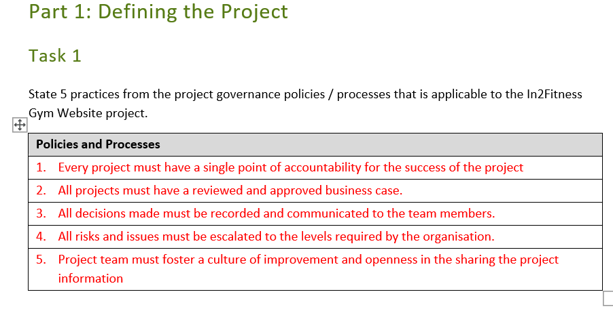
Example answers to Part 1, Task 1-5
DO NOT COPY AND PASTE

Slide 2
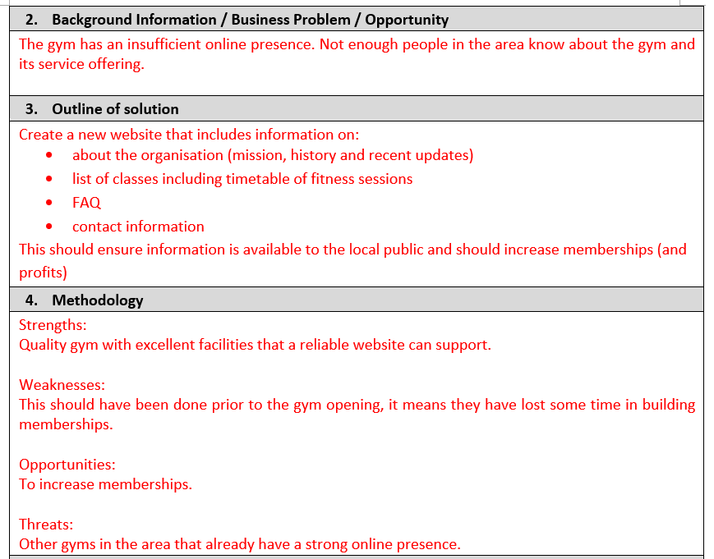
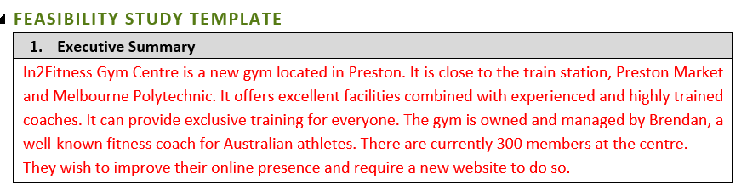
Task 2
DO NOT COPY AND PASTE

Slide 3
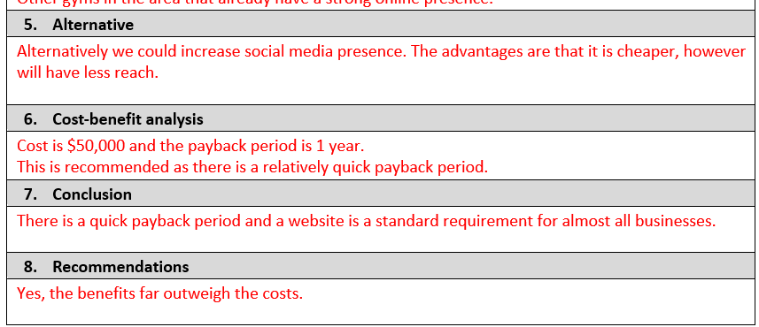
Task 2 CONT.
DO NOT COPY AND PASTE

Slide 4
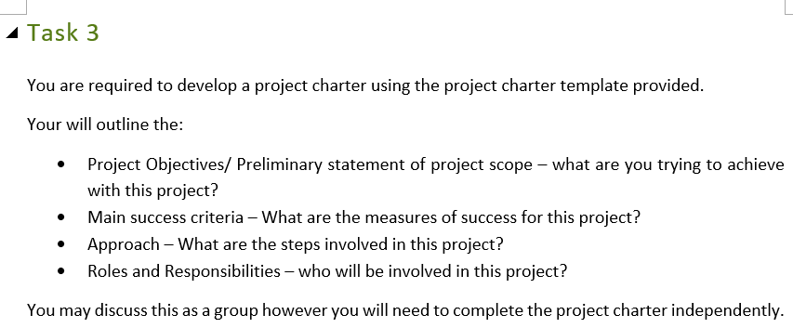
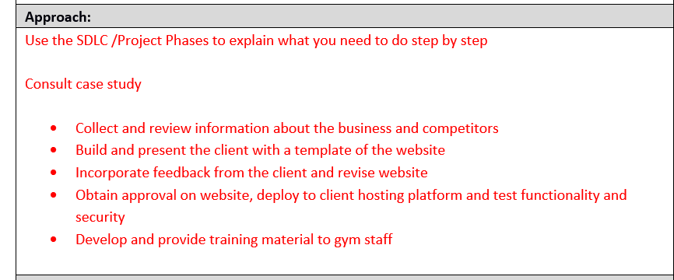
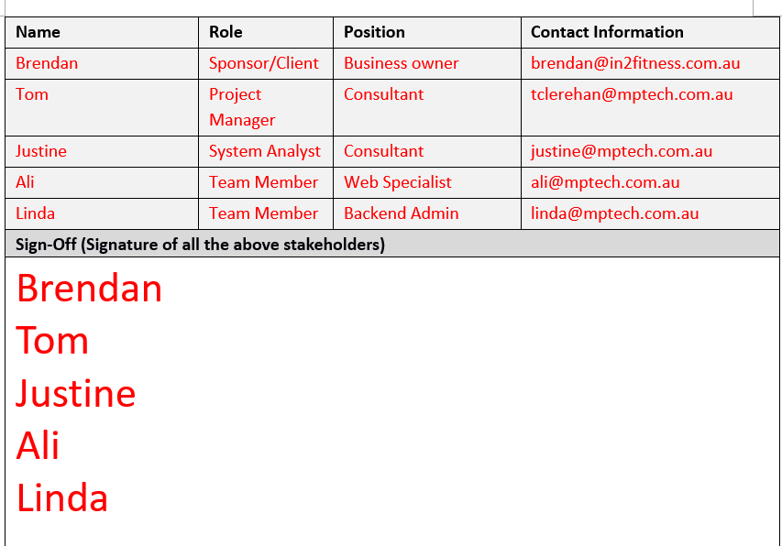
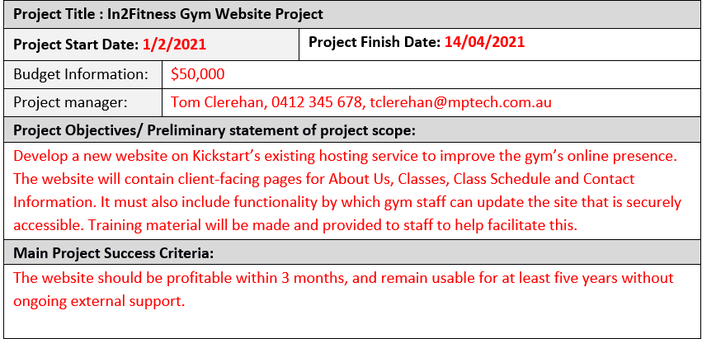
Example answers to Part 1, Task 1-5
DO NOT COPY AND PASTE

Slide 5
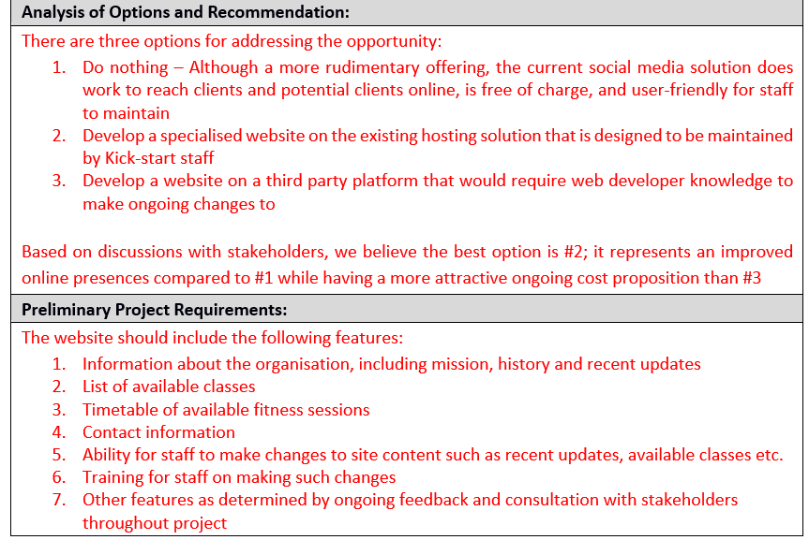
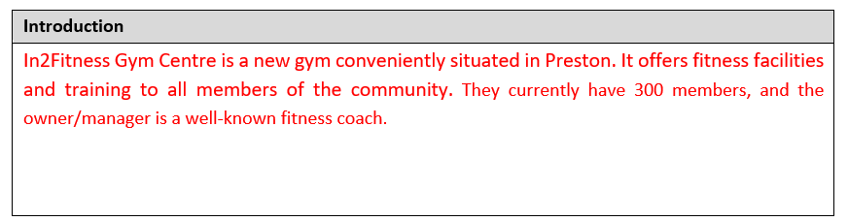
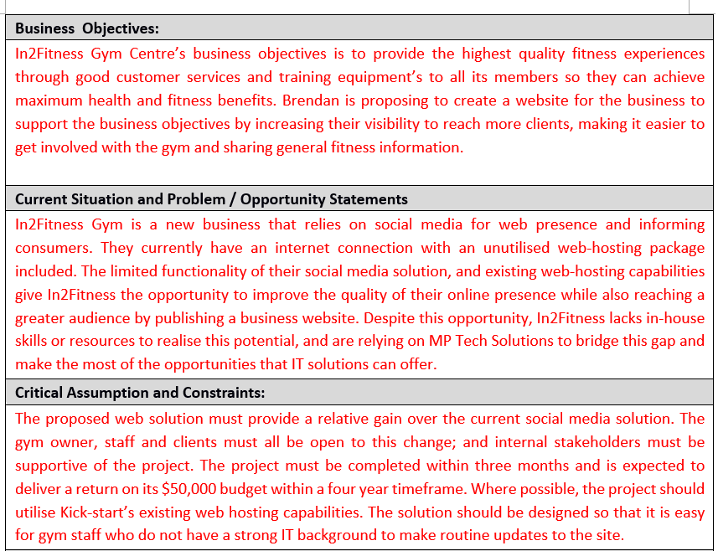
Task 4 Business Case Template
DO NOT COPY AND PASTE

Slide 6
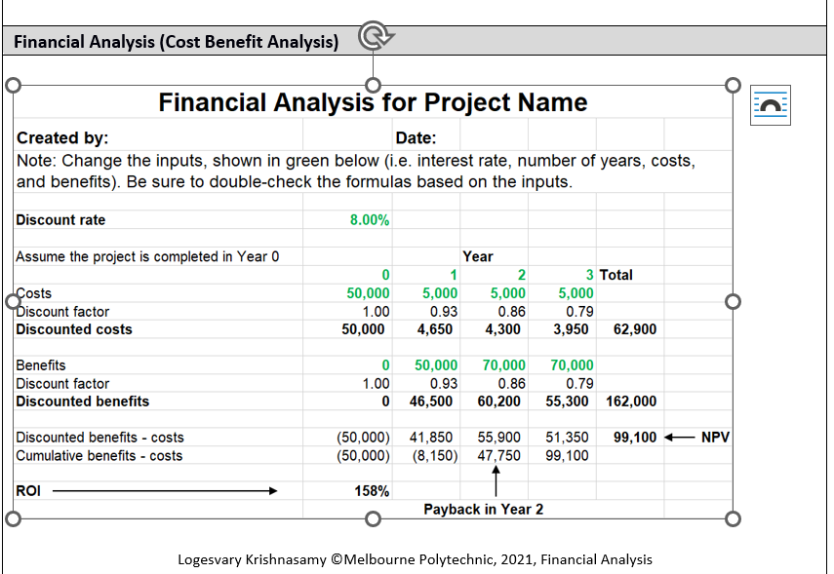
Leave the table as it is. Calculation is already done 保持桌子不变。计算已经完成

Slide 7
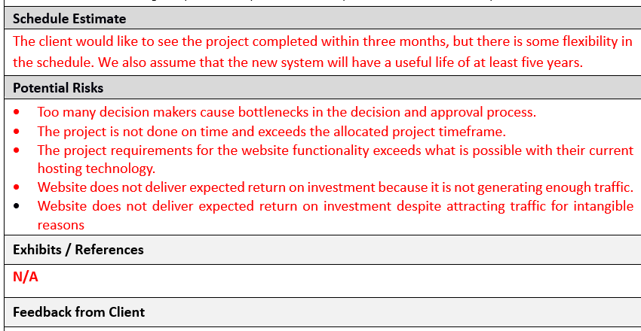
Task 4 Cont.
DO NOT COPY AND PASTE

